Slide 1

HUD-Funded Programs Client File Forms Training

Slide 2
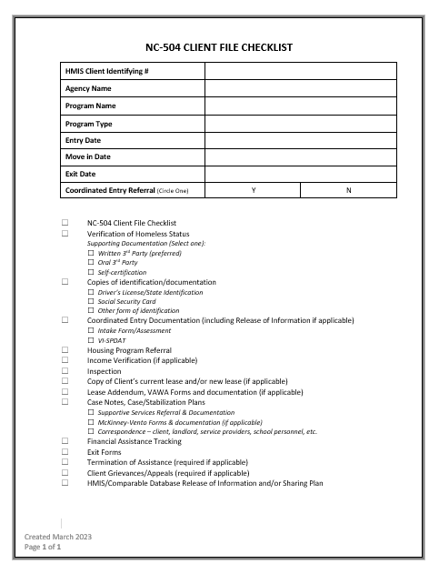
Agenda
Overview of Client Files
Overview of Form Compliance
Available Resources
  HUD Website (program specific)
  ESG Website
  CoC Member Portal
Agency Spotlight: Salvation Army (Greensboro)
  Form Modification
  Client File Systems

Slide 3
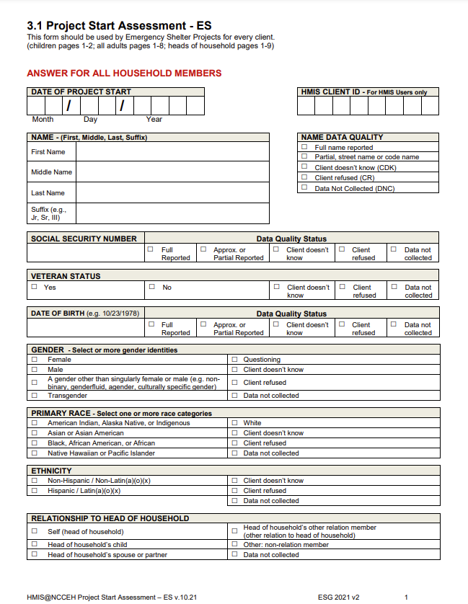
Overview of Client Files
The client’s file is the book that tells the story of the client’s work with your agency. It should detail the services offered/provided, any financial assistance, and any referrals made.
  Who is the client? Who is in their household? What led to their homelessness?
  What program is the client engaging in?
  What makes the client eligible for this program?
  What did your agency provide to/for this client?
  What goals does the client have? What goals have they achieved?
  Who have you spoken to about the client? What suggestions did they make?
  Are you continuing to ensure program eligibility? When? How?

Slide 4
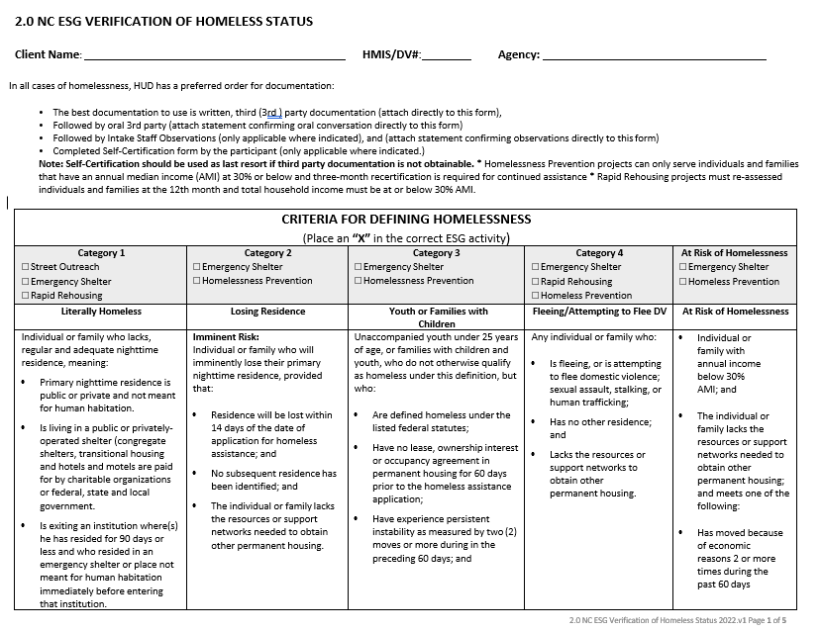
Overview of Form Compliance
Inaccurate, incomplete, and/or missing forms cause gaps in the client’s file & raise questions during the monitoring process. Remember that – typically – those monitoring the file have had no interaction with the client, so your agency’s file is all that we have to assist us in understanding what took place.
Make sure that your files are being audited/monitored internally. This can assist you in finding areas of success and areas where improvement is needed.
Remember that documentation is also important. Where something is not documented in the file, it – essentially – did not happen.

Slide 5
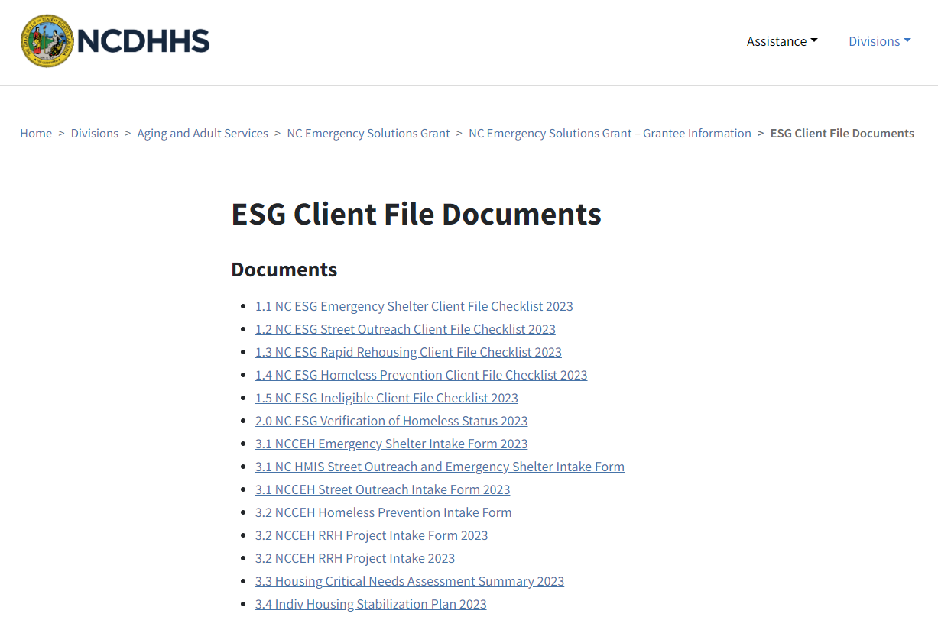
Available Resources
HUD Website: https://www.hud.gov/program_offices/administration/hudclips/forms
ESG Website: https://www.ncdhhs.gov/divisions/aging-and-adult-services/nc-emergency-solutions-grant/nc-emergency-solutions-grant-grantee-information/esg-client-file-documents
  From the ESG Office: As far as we are concerned, we have no problem with ESG forms being used for other programs, but the agency would need to make sure that the ESG forms meet the requirements of the other program.

Slide 6
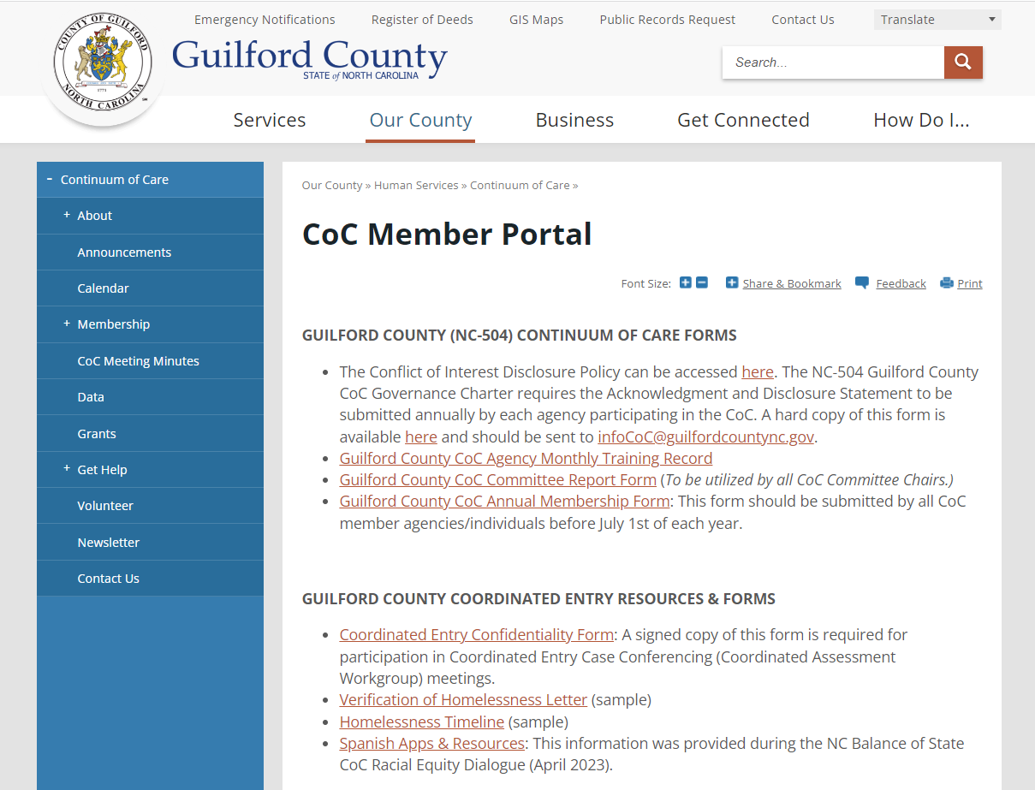

Available Resources: CoC Member Portal
https://www.guilfordcountync.gov/our-county/human-services/continuum-of-care/coc-member-portal
Guilford County CoC Forms
Guilford County Coordinated Entry
Client File Forms
HMIS Documents
ESG Documents, Recordings, & Forms
HUD Information & Resources
Fair Housing
Case Manager Resources
Infectious Disease/COVID-19 Resources
Diversity/Equity Trainings

Slide 7
Agency Spotlight:
Salvation Army - Greensboro

Slide 8
Questions?
Please direct all inquiries concerning this training and/or the CoC Member Portal to: infoCoC@guilfordcountync.gov

