Slide 1

FY 2026 CoC Competition and Youth Homeless Demonstration Program Grants
NOFO: NC-504 Information Session
Thursday, June 18, 2026, at 10:00am

Slide 2
Agenda
Introductions/CA Roles
NOFO Funding
Eligible Projects
Eligible Activities
Match Requirements
How to Apply
Important Dates and Information
Next Steps/Questions
HUD Homeless Definitions
Eligible Applicants

Slide 3
Collaborative Applicant/CoC Lead Team
Cheri Neal- CoC Program Manager
Maria Lyons Legrande- CoC Specialist
Rykiell Turner- CoC Specialist

Slide 4

Collaborative Applicant roles, and responsibilities for NOFO
z
Compile
Compile data and information to complete and submit the NOFO Consolidated Application to HUD.
Facilitate
Facilitate the administrative aspect of the application process.
Receive
Receive applications, supplemental documents, and information from community organizations within the CoC.
Review
Review information and prepare applications for the System Performance Evaluation Committee (SPEC), who is responsible for project prioritization based on the entire CoC’s gaps/needs and priorities.
Conduct
Conduct monitoring of CoC funded projects and provide technical assistance to ensure agencies continue to meet HUD’s standards to receive ongoing funding or for new projects.

Slide 5
FY 2026 HUD Goals and Objectives
(See page 28-34 of the FY 2026 NOFO for more details)
Improving Outcomes
Creating Competition to Improve Innovation and Accountability
Restoring Balance to the Continuum of Care
Prioritizing Treatment and Recovery as a Means to Self-Sufficiency
Promoting Economic Self-Sufficiency
Advancing Public Safety for All
Minimizing Trauma for Vulnerable Populations
Expanding Access Based on Merit, and not Ideology

Slide 6

NOFO Funding
See pages 29-30, page 36, and page 90 of the FY 2026 NOFO for more details
HUD outlines the amount of CoC funding Guilford CoC can apply for and the allocation limit for Bonus amounts in its Special Needs Assistance Programs NOFO. The amounts vary based on how much Congress appropriates and any additional requirements. The primary factor in determining how much a CoC can apply for is its "Annual Renewal Demand" (ARD).
The ARD is based on the total funding amount of each current project in the Guilford CoC (NC 504) that is eligible to apply for funding again in the upcoming competition.
Tier 1 is set at 60% of the CoC ARD

Slide 7
NOFO Funding
See pages 12 and 36 of the FY 2026 NOFO for more details
NC 504’s Preliminary Pro Rata Need (PPRN) is established by HUD using the formula detailed in 24 CFR 578.17(a). The PPRN is amount released during the NOFO competition.
NC 504 Annual Renewal Demand (ARD) is based on the total amount of all the Guilford CoC’s projects that will be eligible for renewal in the CoC Program Competition.
Additional funding:
  DV Bonus project(s) up to 20% of PPRN
  CoC Bonus project(s) up to 15% of Final Pro Rata Need (FPRN)
  Guilford CoC Planning grant is up to 5% of Final Pro Rata Need (FPRN)
*HUD releases an estimated amount at start of competition and then the final funding available for NC 504 for the competition. Always subject to change during competition/check regularly.
FY 2026 Estimate Annual Renewal Demand (ARD)
ARD: TBD
CoC Bonus: TBD
DV Bonus: TBD

Slide 8
Who can apply?
(See page 9 of the FY 2026 NOFO for details)
To apply for CoC Program funding, an organization must be an eligible applicant as outlined in the CoC Program Interim Rule, which defines eligible applicants as:
  Nonprofit organizations,
  States,
  Local governments,
  Instrumentalities of State or Local governments, and
  Faith-Based Organizations
  *Individuals, For-profit entities, and Educational Organizations are not eligible to apply for grants or to be subrecipients of grant funds.

Slide 9
Grantee Requirements
Grant Award Process
  Complete an Environmental Review (24 CFR 578.31)
  Maintain complete, up-to-date written records and procedures for each CoC Program-funded project.
  Documentation of financial feasibility
  Documentation of meeting Match requirements
Coordinated Entry (CE) Participation
  All CoC funded projects must receive their referrals via CE
Homeless Management Information System (HMIS) or comparable database Participation
  Required to record all participation information
  You can record participation data elsewhere too, but you MUST record it in HMIS.
Federal Reporting Requirements
  Annual Performance Report (APR)

Slide 10
HUD Homeless Definitions
Category 1: Literally Homeless
  An individual or family who lacks a fixed, regular, and adequate nighttime residence
Category 2: Imminent Risk of Homelessness
  An individual or family who will imminently lose their primary nighttime residence
Category 3: Homeless Under Other Federal Statutes
  Unaccompanied youth under 25 years of age, or families with children and youth, who do not otherwise qualify as homeless under this definition
Category 4: Fleeing/Attempting to Flee Domestic Violence
  Any individual or family who is fleeing, or is attempting to flee, domestic violence, dating violence, sexual assault, stalking, or other dangerous or life-threatening conditions that relate to violence against the individual or a family member, including a child, that has either taken place within the individual's or family's primary nighttime residence or has made the individual or family afraid to return to their primary nighttime residence

Slide 11

Permanent Supportive Housing (PSH)
(See pages 40, 42, 66-68 of the FY 2026 NOFO for more details)
Permanent Supportive Housing (PSH) for persons with disabilities who are literally homeless. PSH can only provide assistance to individuals with disabilities and families in which one adult or child has a disability. Supportive services designed to meet the needs of the program participants must be made available to the program participants.

Slide 12
Rapid Rehousing (RRH)
(See pages 40, 42, 66-68 of the FY 2026 NOFO for more details)
May provide supportive services, as set forth in § 578.53, and/or short-term (up to 3 months) and/or medium-term (for 3 to 24 months) tenant-based rental assistance, as set forth in § 578.51(c), as necessary to help a homeless individual or family, with or without disabilities, move as quickly as possible into permanent housing and achieve stability in that housing. When providing short-term and/or medium-term rental assistance to program participants, the rental assistance is subject to § 578.51(a)(1), but not § 578.51(a)(1)(i) and (ii); (a)(2); (c) and (f) through (i); and (l)(1).

Slide 13
Transitional Housing (TH)
(See pages 42 & 63 of the FY 2026 NOFO for more details)
Transitional housing (TH) is designed to provide homeless individuals and families with the interim stability and support to successfully move to and maintain permanent housing. Transitional housing may be used to cover the costs of up to 24 months of housing with accompanying supportive services. Program participants must have a lease (or sublease) or occupancy agreement in place when residing in transitional housing.
A nonprofit may provide the direct services of a CoC-funded transitional housing project. However, a CoC-funded transitional housing project's rental assistance must be administered by a unit of local government, state government or PHA.
Until HUD publishes the CoC Program final rule that lists the eligible costs for administering leasing and rental assistance, recipients and subrecipients may use 24 CFR 582.105(e)(2) to identify eligible leasing/rental assistance administration activities, which include:
  Processing rental payments to landlords;
  Examining participant income and family composition;
  Providing housing information and assistance;
  Inspecting units for compliance with housing quality standards; and
  Receiving new participants into the program

Slide 14
Supportive Services Only- (SSO & Stand Alone) (See pages 40, 64-65 in the FY 2026 NOFO for more details)
Project applicants may apply for SSO projects consistent with 24 CFR 578.37 and 578.53, including projects with the outreach service activity described at 24 CFR 578.53(e)(13) to individuals and families primarily residing in places not meant for human habitation. Projects that are primarily providing these outreach services, and identify themselves as such in the project application, must meet the project quality threshold criteria in Section V.A.4.c.(4)(c) of this NOFO. All other SSO projects, except those dedicated to coordinated entry, must meet the threshold criteria in Section V.A.4.c.(4)(b) of this NOFO.

Slide 15
Supportive Services Only-Coordinated Entry (SSO-CE)
See page 66 of the FY 2026 NOFO for more details
Funds awarded through a Supportive Services Only - Coordinated Entry (SSO-CE) grant may be used for a range of supportive services that directly relate to carrying out CE activities, such as conducting outreach to sheltered and unsheltered homeless persons and families (including initial assessment, crisis counseling, and addressing urgent physical needs) and connecting persons experiencing homeless to housing and other resources.

Slide 16
Homeless Management Information System (HMIS) (see pages 68 of the FY 2026 NOFO for more details)
Funds under this component may be used only by Homeless Management Information System (HMIS) Lead Agencies. The HMIS Lead Agency is the entity designated by the CoC to operate the CoC's HMIS on the CoC's behalf.
Under the HMIS component, funds pay for leasing a structure in which the HMIS operates, for operating the structure in which the HMIS is housed, and/or for covering other costs related to establishing, operating, and customizing a CoC’s HMIS. Other recipients and subrecipients may not apply for funds under the HMIS program component, but they may include costs associated with contributing data to the CoC’s HMIS within their project under another program component (PH, TH, SSO, or HP).

Slide 17
Domestic Violence Bonus (DV Bonus) (See page 91 of the FY 2026 NOFO for more details)
DV Bonus project are new projects for the following project types:
  One new SSO-CE DV Bonus project
  Transitional Housing (TH) projects
  Permanent Housing- Rapid Rehousing (PH-RRH) projects
DV Bonus projects must serve individuals and families who are fleeing or attempting to flee domestic violence, dating violence, sexual assault, and stalking and who qualify as homeless under paragraphs (1) or (4) of the definition of homeless at 24 CFR 578.3 or Section 103(b) of the McKinney-Vento Homeless Assistance Act with the following exception:
  PH-RRH, Joint TH/PH-RRH, SSO- projects may serve individuals and families who are fleeing or attempting to flee domestic violence, dating violence, sexual assault, and stalking who qualify as homeless under paragraph (3) of 24 CFR 578.3 if the CoC is approved to serve persons in paragraph (3).

Slide 18
Transition Grant Process (Renewal Applicants)
See page 21 of the FY 2026 NOFO for more details
A Transition grant is an application to fund a new CoC project through the reallocation process to transition eligible CoC renewal project(s) (including a Special NOFO project or DV Renewal project) from one program component to another eligible component over a 1-year period. Transition grant applications awarded FY 2026 funds must fully transition to the new component by the end of the 1-year grant term and may only apply for renewal in the next CoC Program Competition under the component to which it transitioned.

Slide 19
Leasing
Leasing is an eligible cost category under the PH, TH, SSO, and HMIS program components. Funds may be used to lease individual units or all or part of structures. Rents must be reasonable, and, in the case of individual units, the rent paid cannot exceed HUD-determined Fair Market Rents (FMRs). Leasing funds may not be used for units or structures owned by the recipient, subrecipient, their parent organization(s), any other related organization(s), or organizations that are members of a partnership where the partnership owns the structure, without a HUD-authorized exception. When leasing funds are used to pay rent on units, the lease must be between the recipient or the subrecipient and the landowner, with a sublease or occupancy agreement with the program participant. The recipient may, but is not required to, charge the program participant rent or an occupancy charge, consistent with the parameters specified in the interim rule.

Slide 20
Rental Assistance
Rental assistance is an eligible cost category under the PH and TH program components and may be tenant-based (TBRA), sponsor-based (SBRA), or project-based (PBRA), depending upon the component type. Rental assistance may be short-term for up to 3 months, medium-term for 3 to 24 months, or long-term for more than 24 months. The length of assistance depends upon the component type under which the cost is funded. Recipients must serve as many program participants as identified in their funding application to HUD, but, if the amount reserved for the term of the grant exceeds the amount needed to pay actual costs, the excess funds may be used to cover property damage, rent increases, or the rental needs of a greater number of program participants.
  TBRA. Program participants select any appropriately sized unit within the CoC’s geographic area, although recipients or subrecipients may restrict the location under certain circumstances to ensure the availability of the appropriate supportive services.
  SBRA. Program participants must reside in housing owned or leased by a sponsor organization and arranged through a contract between the recipient and the sponsor organization.
  PBRA. Program participants must reside in housing provided through a contract with the owner of an existing structure whereby the owner agrees to lease subsidized units to program participants. Program participants may not retain their rental assistance if they relocate to a unit outside the project.
When rental assistance funds are used to pay rent on units, the lease must be between the program participant and the landowner. Each program participant, on whose behalf rental assistance payments are made, must pay a contribution toward rent consistent with the requirements of the interim rule.

Slide 21
Supportive Services
Supportive services are eligible costs under the PH, TH, and SSO program components. 24 CFR 578.53 specifies grant funds may be used to pay the eligible costs of supportive services that address the special needs of the program participants.
  For Transitional Housing supportive services must be made available to residents throughout the duration of their residence in the project
  Permanent Supportive Housing projects must provide supportive services for the residents to enable them to live as independently as is practicable throughout the duration of their residence in the project.
  Rapid rehousing projects must require the program participant to meet with a case manager not less than once per month as set forth in § 578.37(a)(1)(ii)(F), to assist the program participant in maintaining long-term housing stability.
  Supportive Services Eligible Costs: 24 CFR 578.53(e)

Slide 22
Administrative (up to 10% of the total budget)
See page 85 of the FY 2026 NOFO for more details
Recipients may use up to 10 percent of any grant, excluding the amount for CoC planning and Unified Funding Agency (UFA) costs, established through the CoC Program NOFO for project administrative costs. These costs include expenses related to the overall administration of the grant (24 CFR part 578.59), such as management, coordination, monitoring, evaluation activities, and environmental review.

Slide 23
Operating Costs
Operating costs are eligible under the PH, TH, and HMIS program components. Funds may be used to pay the day-to-day operating costs in a single structure or individual housing units, including maintenance (such as scheduled replacement of major systems), repair, building security (when CoC Program funds pay for more than 50 percent of the facility by unit or area), electricity, gas, water, furniture, equipment, property insurance, and taxes. These costs may not be combined with rental assistance costs within the same unit or structure, and operating costs are not eligible under the SSO program component.

Slide 24
Homeless Management Information System (HMIS)
Costs related to contributing client data to or maintaining data in the CoC’s HMIS or a comparable database for victim services providers or legal services providers are eligible costs under the PH, TH, SSO, and HMIS program components. Eligible HMIS costs include hardware, equipment, and software costs; training and overhead; and staffing costs associated with contributing data to the HMIS designated by the CoC for its geographic area.

Slide 25
CoC Match Requirements (see page 26 of the FY 2026 NOFO for more details)
Grantees must match total grant funds awarded under the project, except for leasing funds, with no less than 25 percent of funds or in-kind contributions from other sources (some waivers may apply and will be detailed in the NOFO).
Written documentation of the donation of in-kind goods and/or equipment must be provided on the source agency's letterhead, signed, and dated by an authorized representative of the source agency. Cash match and some in-kind match requires a written commitment that may consist of a signed letter, memorandum of understanding (in-kind), or other documented evidence of a commitment (who, what, when, and method to determine value). Cash match does not require MOU.
Match documentation must, at a minimum, include the following: value, specific date goods and services will be available and eligible type, and grant term and availability of match must be the same.
Match must be used for eligible activities to be provided in the specific project.
Match does not need to be made for each budget line item in the project’s budget (but, may be easiest for tracking match, especially with staff time).

Slide 26
Documenting Match: Best Practices
Implement quarterly review and reconciliation to ensure system is working properly and project is being supported/participants are accessing match covered activities. (third-party billing data, e.g.);
Provide partner agencies with uniform guidance, including tracking format/form;
Obtain third party billing data and verify activities occurred (case notes, e.g.)
Do not wait until the end of the grant year to reconcile match;
HUD requires the 25% match for the funds expended in the grant at the end of the performance period/grant closeout.
HUD has recently clarified that security deposits returned to recipients are not program income but a ‘refund’ of project funds. This means it would also be excluded as eligible match under the CoC.

Slide 27
Remember: Match Requirements
Grantees must match all grant funds, except for leasing funds, with no less than 25 percent of funds or in-kind contributions from other sources.
Match does not have to be an approved cost for the project but must be an eligible cost under the specific component/project type.
Match is grant by grant basis! Resources already used as match cannot be used for another grant (“double-dipping”).
Committing match is a contractual commitment and limits the use of the funding to eligible activities under the CoC Program Interim Rule.
Leveraged funds have less restrictive use requirements-follow guidance detailed in the NOFO.

Slide 28
Overview of Local Process for NOFO Competition
Consolidated (NOFO) Application Submitted by CoC
Competition/Application Information Released and Community is Notified
CoC Provides Informational and Instructional Trainings and Technical Assistance
CoC Project Applications Due
CoC Staff Provides Applications to SPEC
SPEC Reviews Applications and Completes Ranking & Review
Funding Recommendations Announced & Voted on by CoC Board/Membership

Slide 29
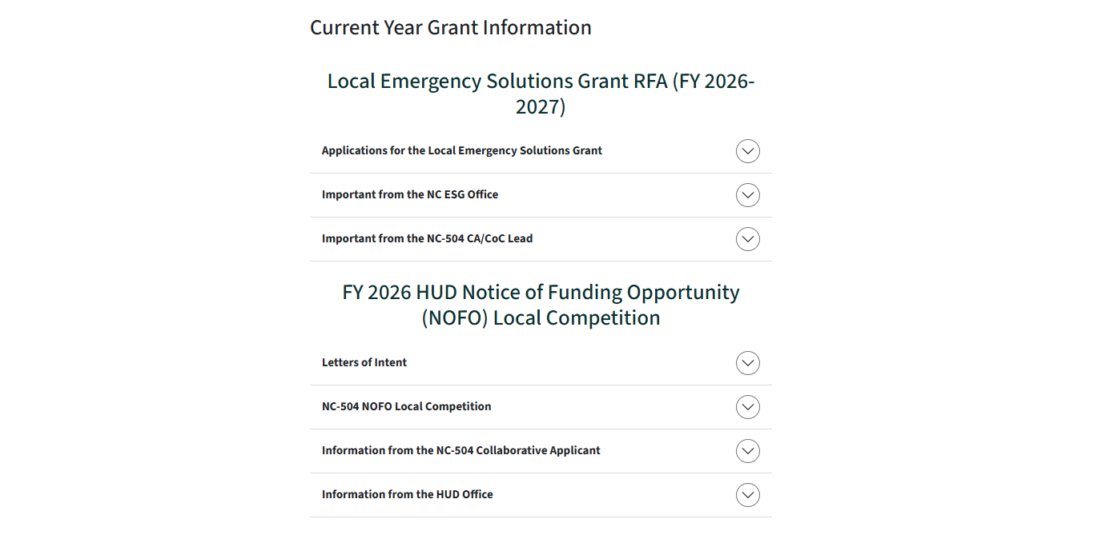

NC-504 Local Competition Process

Slide 30
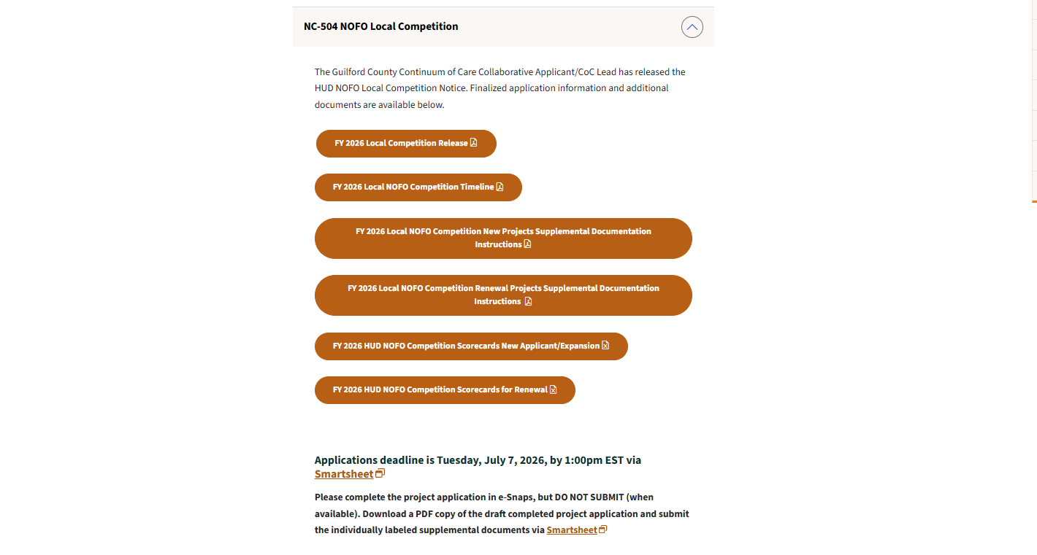
NC-504 Local Competition Process

Slide 31
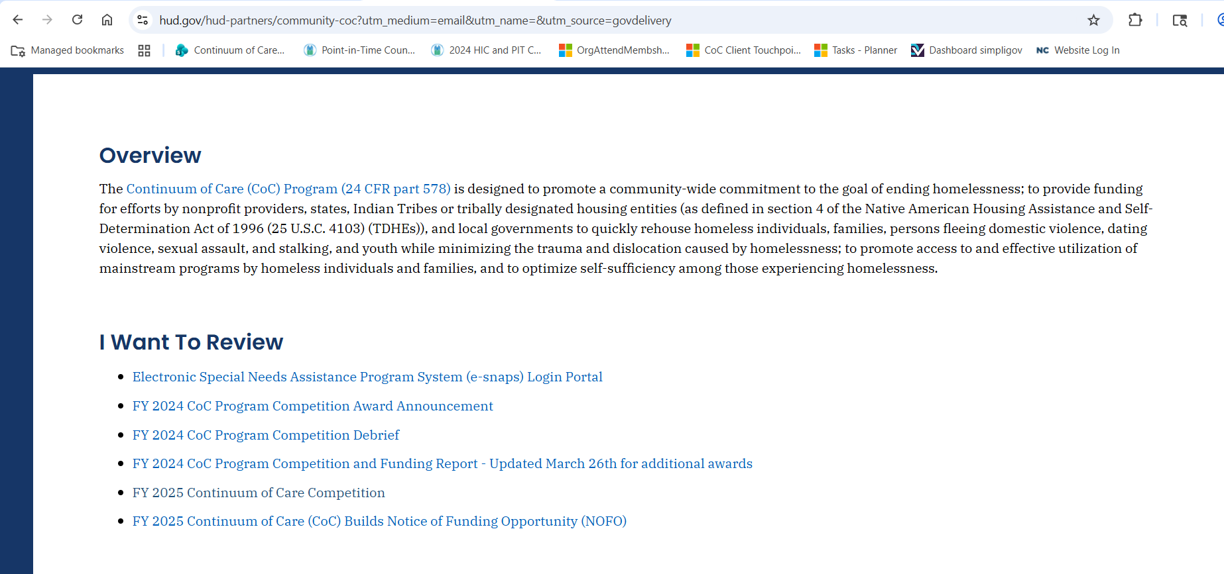
How to Access the Project Application

Slide 32
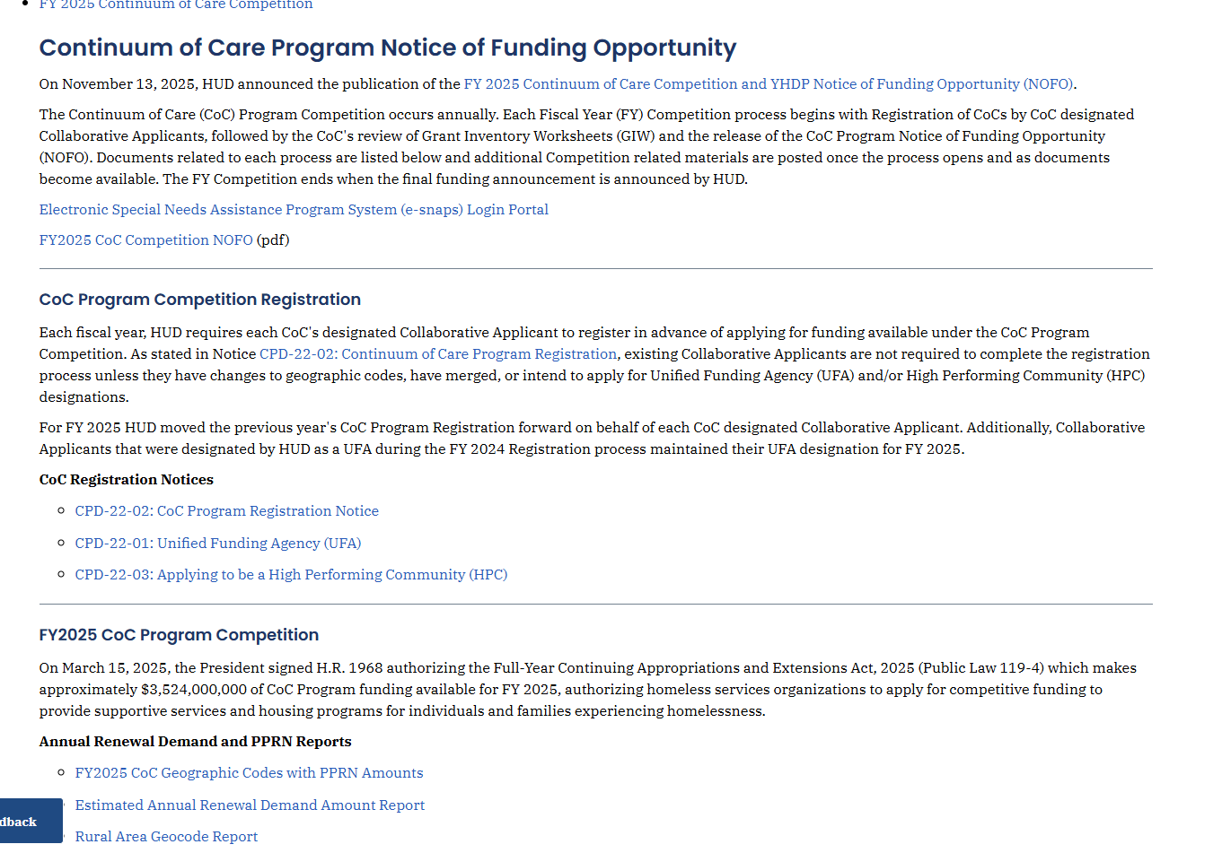
How to Access the Project Application

Slide 33
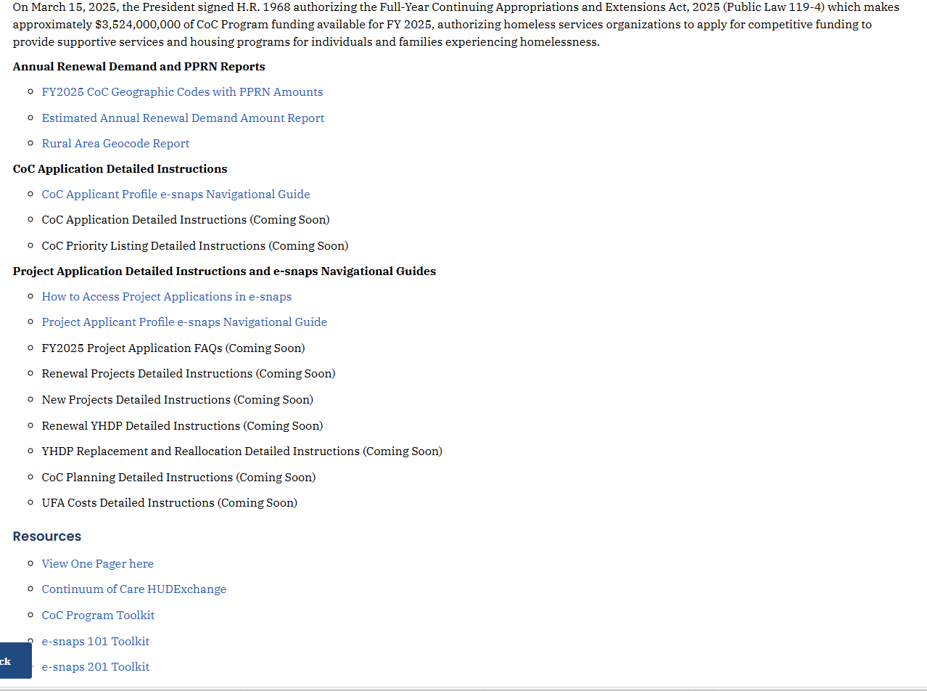
How to Access the Project Application

Slide 34
Important Pages of the FY 2026 NOFO
Threshold Criteria: page 59
Renewal Project Threshold: page 61
New Project Threshold: page 62-69
Merit Review: pages 69-84
Risk Review: pages 86-87
HUD Selection Process: pages 87-88

Slide 35
Important Dates for the FY 2026 HUD NOFO Local Competition
Application Deadline is Tuesday, July 7, 2026, at 1:00pm EST via Smartsheet
Office Hours: June 24, 2026, at 9:30am
Office Hours: July 1, 2026, at 1:00pm
Technical Assistance Cut-Off: July 6, 2026

Slide 36
Next Steps
READ THE NOFO
Attend Office Hours if you have questions
Follow all directions provided within the local competition
Deadline is Tuesday, July 7, 2026 at 1:00pm EST
Email infococ@guilfordcountync.gov with any questions.

Slide 37
Important Links
(shared during the presentation)
CoC Program Interim Rule
Overview of Application and Grant Award Process
CoC Program Components and Eligible Costs
CoC Program Requirements
CoC Grant Administration

Slide 38

Questions?

