Slide 1
Economic Services Presentation
Adult Medicaid Division
RaGeeni Coleman, Eligibility Supervisor

Slide 2
Objective:
What is Adult Medicaid? What benefit programs are available?
Eligibility Requirements & Documents used for Verifications
Caseworker’s Responsibility & Agency Tools
Mandatory Forms
Additional Forms
Mailing System

Slide 3
What is adult Medicaid?
Medicaid provides medical assistance to aged, blind and disabled residents of North Carolina whose income is below amounts set by the federal and state government. Medicaid is governed by federal and state regulations. It helps people pay for medical expenses in private living arrangements, long-term care facilities and assisted living facilities. To receive Medicaid, you must meet various eligibility requirements.

Slide 4
Adult Medicaid Programs

Slide 5
Adult Medicaid umbrella
MAABD-Medical Assistance to the Aged, Blind & Disabled.
MQB- Medicare Qualified Beneficiary
LTC-Long Term Care
CAP, PACE and Special Assistance
HCWD-Health Coverage for Workers with Disabilities.

Slide 6
Eligibility Requirements

Slide 7
To be eligible for any Adult Medicaid program, an applicant must:
Be a US Citizen or Qualified Alien.
Be a resident of North Carolina, and not receiving benefits in another state.
Not be an inmate of a public institution unless it is a North Carolina state prison.
Not be in an institution for mental disease with more than 16 beds unless the individual is at least 65 years old or less than 21 years old receiving inpatient psychiatric services.
Provide his social security number or apply for a number if he does not have one.
Apply for all benefits for which he may be eligible.
Not have countable assets that exceed the resource limit.
Be in financial need according to the income limit.

Slide 8
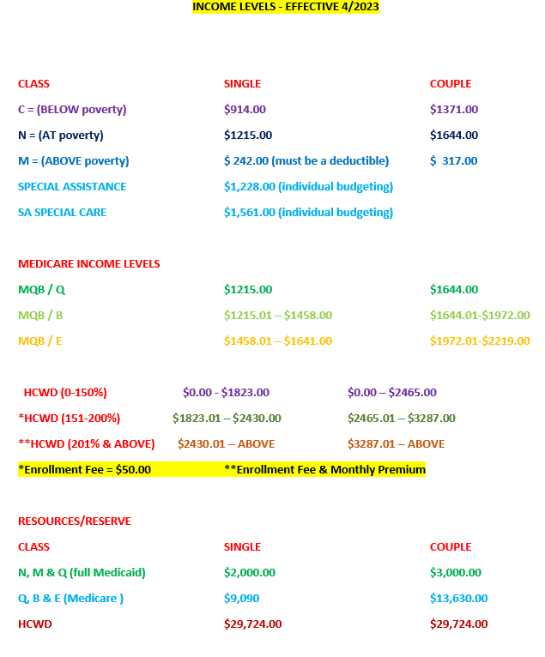
Income & Resource Limits

Slide 9
Verifications

Slide 10
The following are examples of documents that can be used for verifictions
North Carolina Driver License/ID
Rent/Lease Statement
Paystubs
Social Security Card
Voter Registration Card
Birth Certificate/LPR Card
Bank Statements
Other benefits that require verification.

Slide 11
Caseworker Responsibility

Slide 12
Caseworker Responsibility
Eligibility Caseworkers should perform all the necessary steps to properly determine if a household is eligible for program assistance. Having taken all avenues necessary for determination, the Eligibility Caseworker will properly deny any ineligible members.

Slide 13
Agency Tools
NC FAST Documentation
Northwoods/Compass Pilot
Guilford County Property Tax Website
North Carolina State Board of Elections
ONLINE VERIFICATION (OLV)
ASSET VERIFICATION SYSTEM (AVS)
The Work Number
SAVE

Slide 14
Mandatory & Additional Forms

Slide 15
ADULT MEDICAID
Mandatory Forms
DHB-5097 REQUEST FOR INFORMATION
DMA-5094 Rights & Responsibility
DSS-8227 Citizenship & Immigration Status
DMA-5057 Transfer of Assets/Sanction
DMA-5051/5052 Estate Recovery
DMA-5046 Transportation
DSS-10001 Language Services Agreement (Foreign clients)
Voter registration form and cover letter

Slide 16
Adult Medicaid Additional Forms
DMA-5202C Designation of Authorized Representative
DMA-5027 VA Income Verification
DSS-8113 Wage Form
DMA-5157 Vehicle Rebuttal
DMA-5155 Life Insurance
DMA-5152/5153 Residency Declaration
DMA-5202C Designation of Authorized Representative
DSS-3431 Bank Consent Form

Slide 17
Mailing System

Slide 18
Client Mail with Agency P.O.Box
PO Box 3388
Greensboro, NC 27405
**Only Program Specific Mail

Slide 19
Agency PO Box Mail submission
Submit
Submit Envelop with client and caseworker name clearly visible
Date
Date submitted to the Reception desk for client
Submit
Submit to correct agency. For example, if a client is in High Point, send letter via Interoffice mail to High Point for client to pickup.
Reach out
Always reach out to the client and/or Authorized Representative to make sure they are aware they have mail.

Slide 20
Questions?

Slide 21
Thank you for your time and attention.
Please contact Erica Reeves, Adult Medicaid Program Manager at ereeves@guilfordcountync.gov if you have any further questions.

